Slide 1

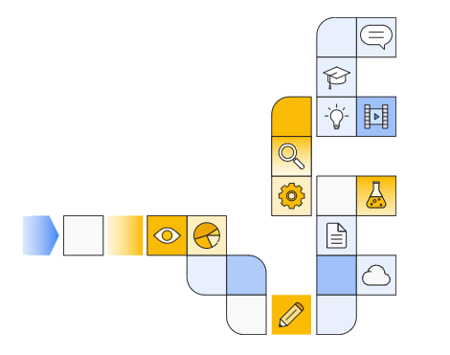
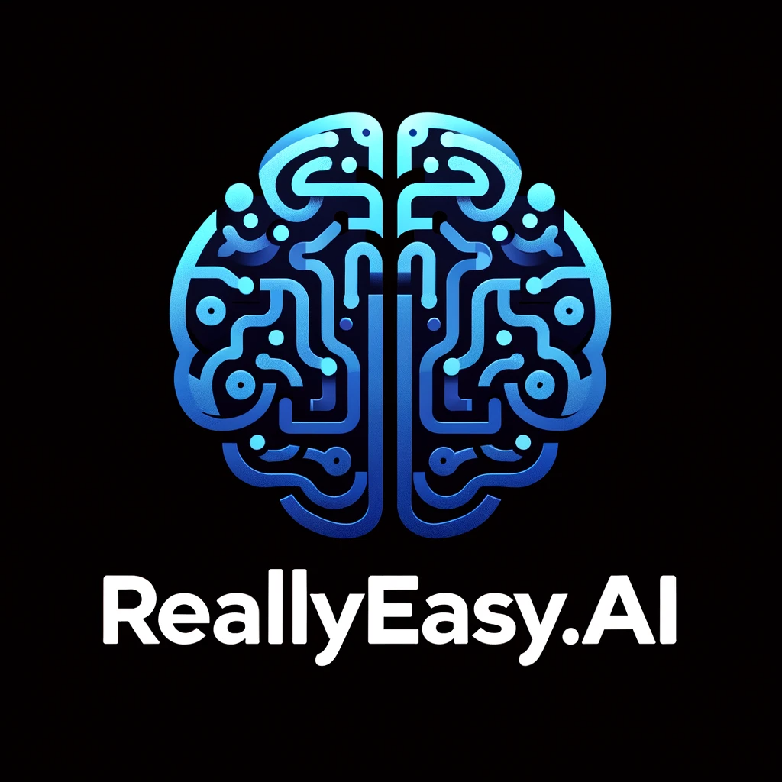
Google cloud Introduction to Vertex AI Studio Part 3

Slide 2
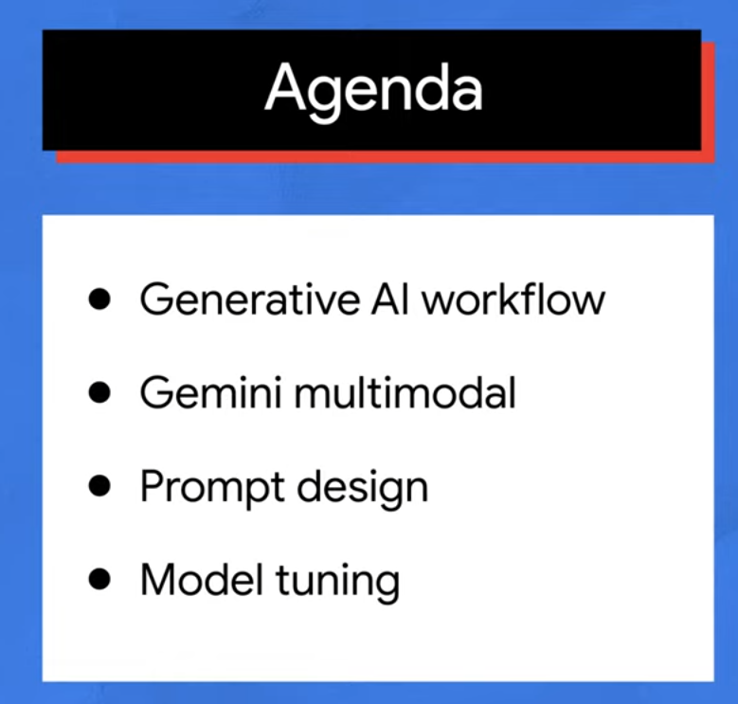

Slide 3
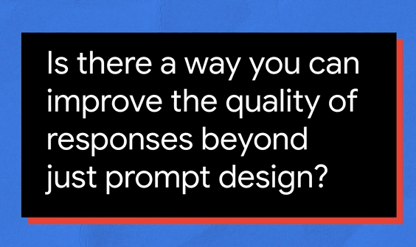
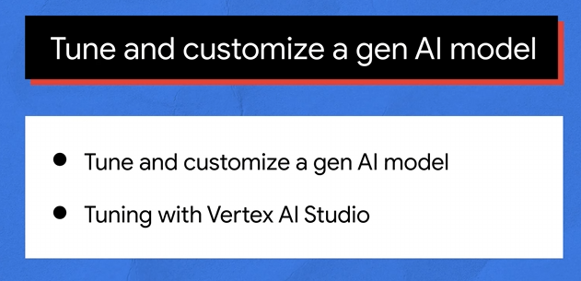

Slide 4
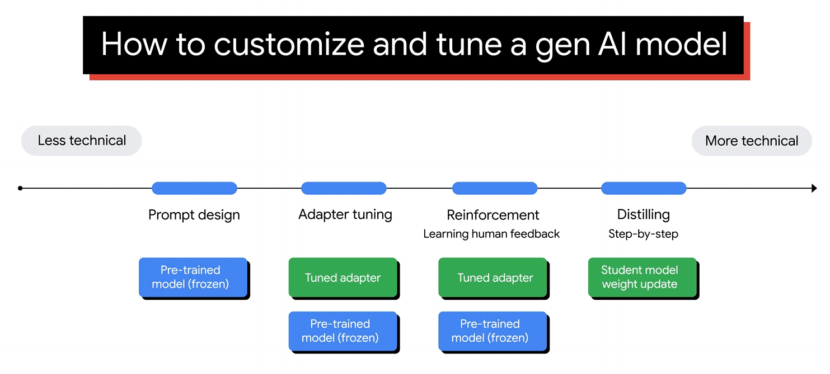

Slide 5
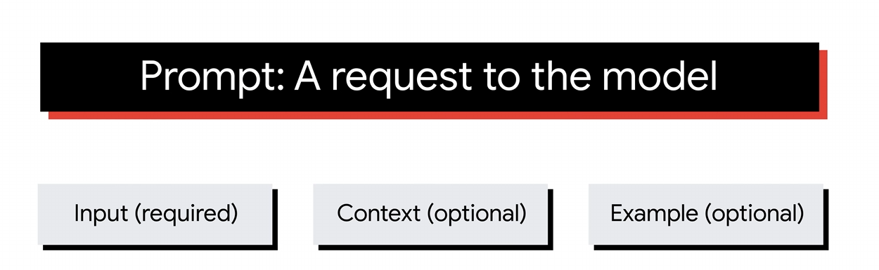
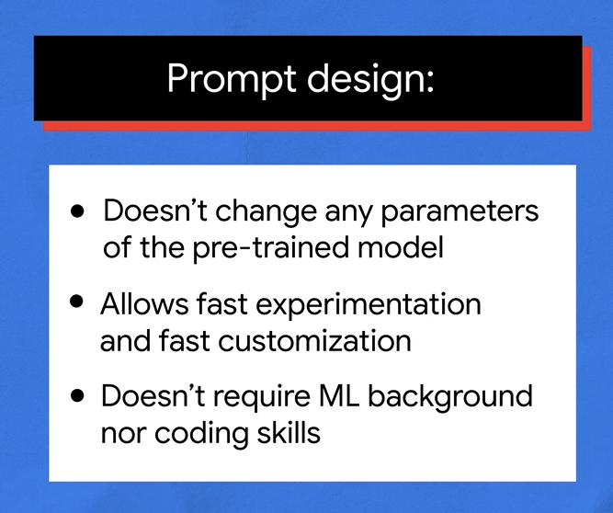

Slide 6
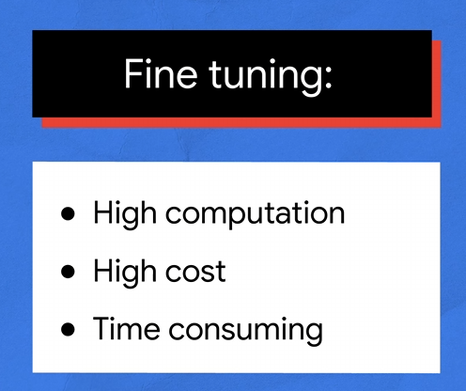
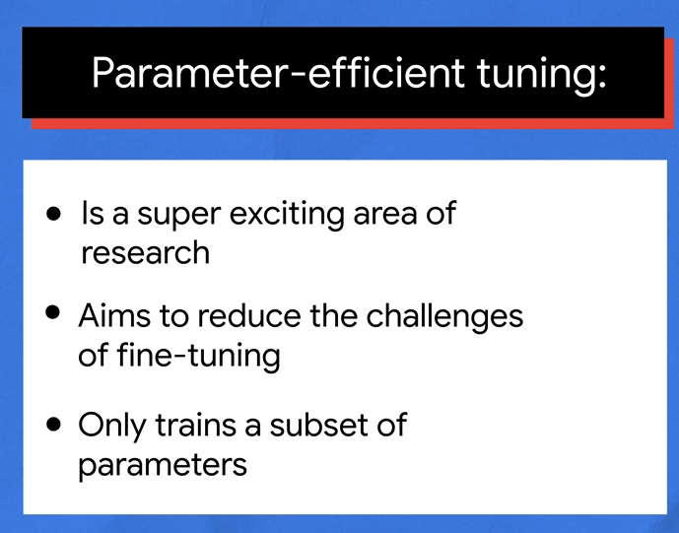

Slide 7
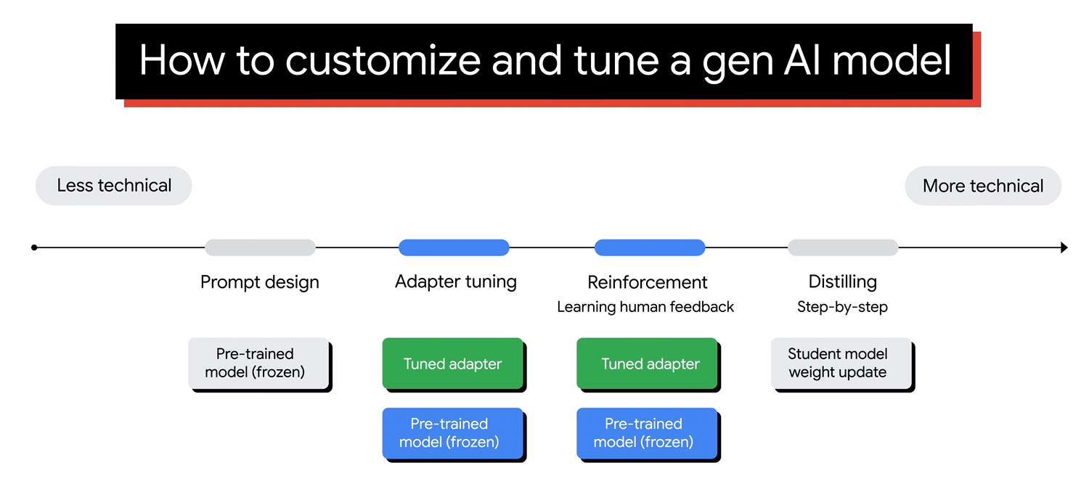

Slide 8
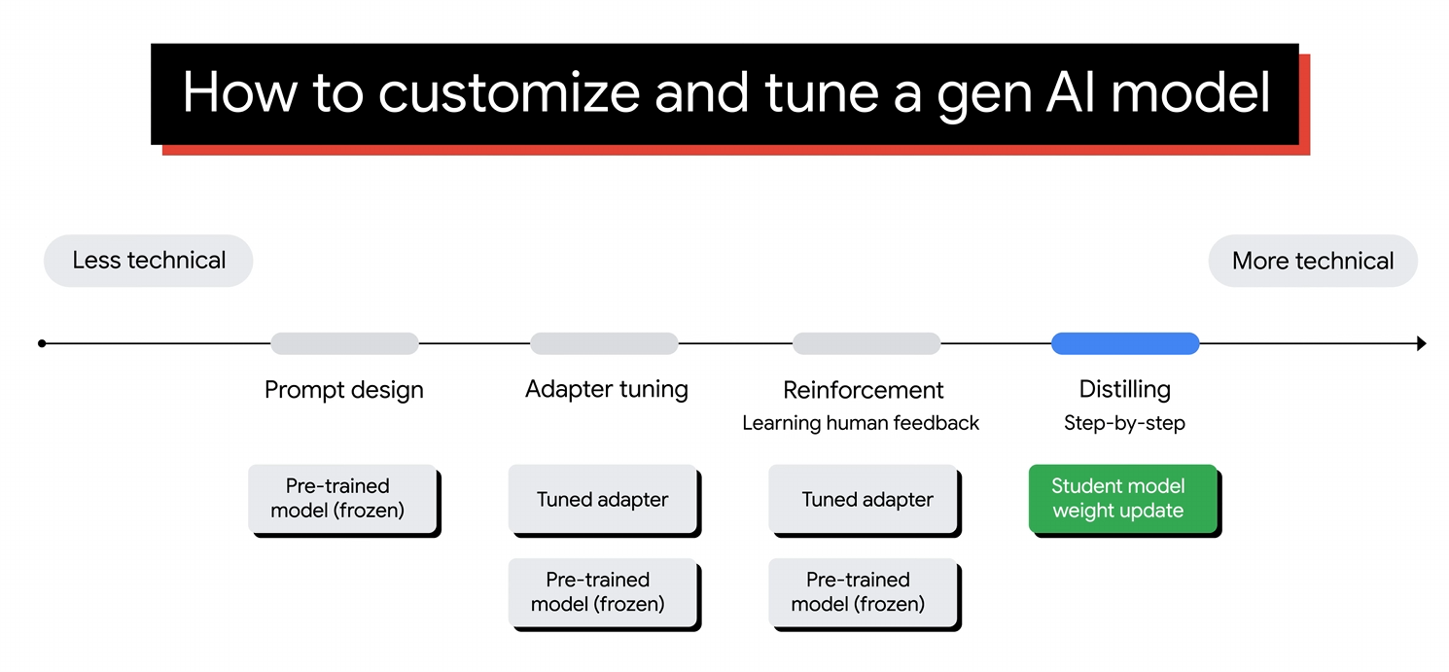

Slide 9
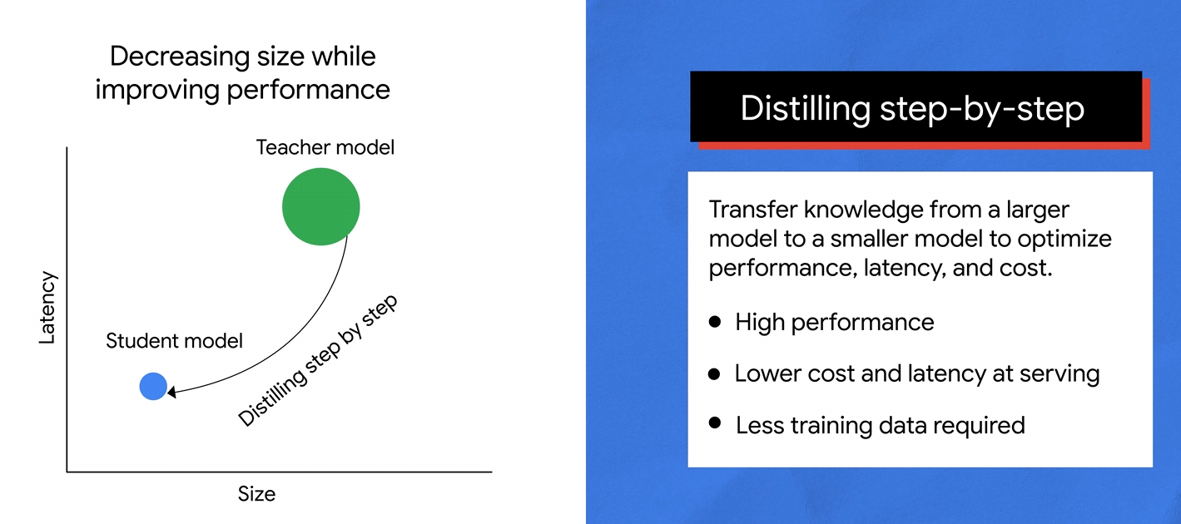

Slide 10
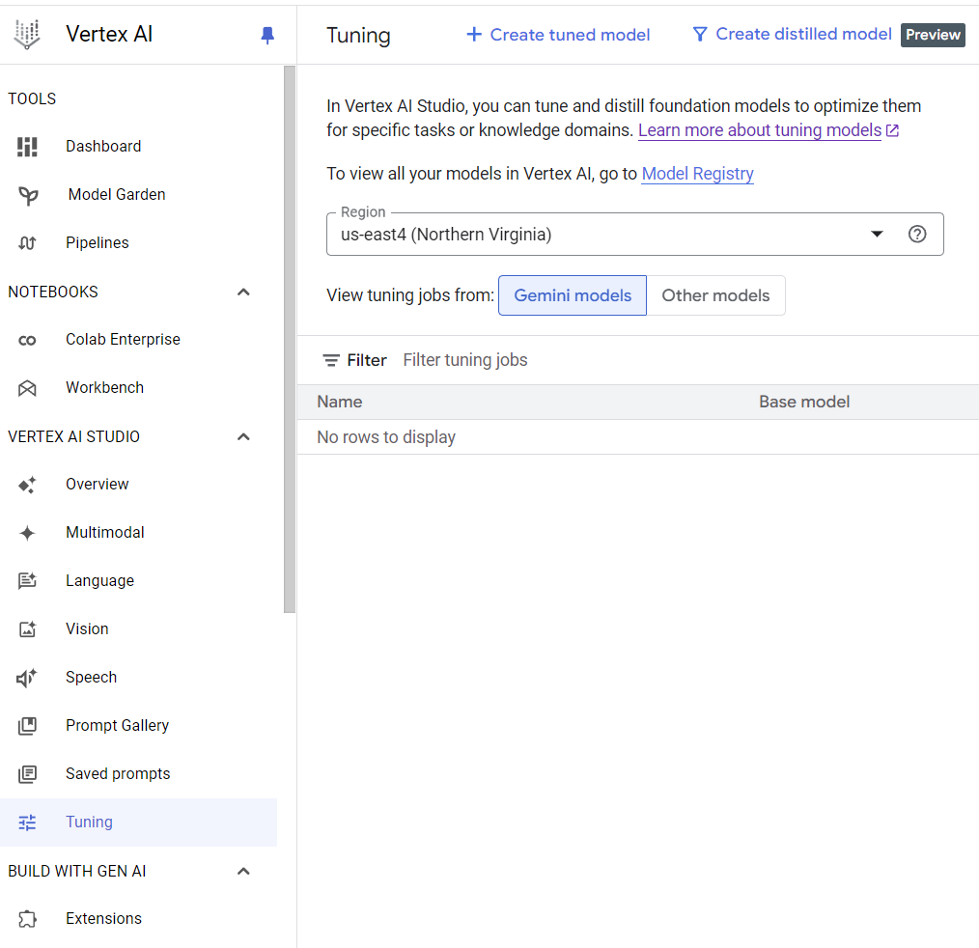

Slide 11
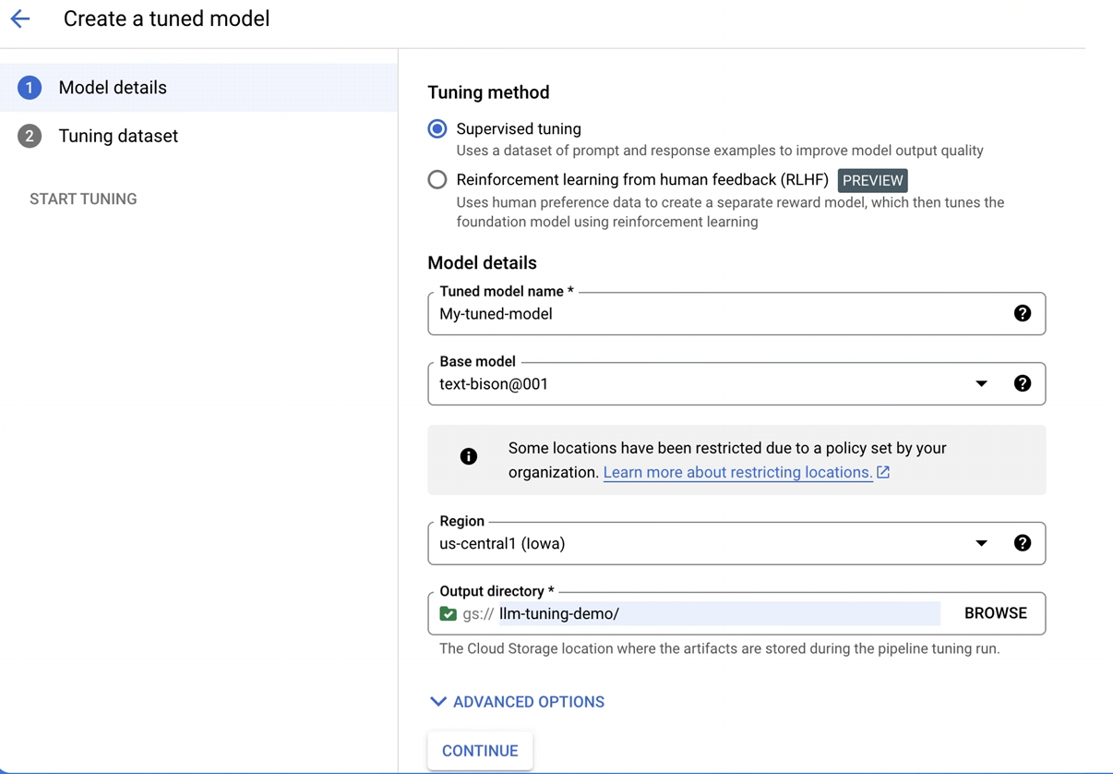

Slide 12
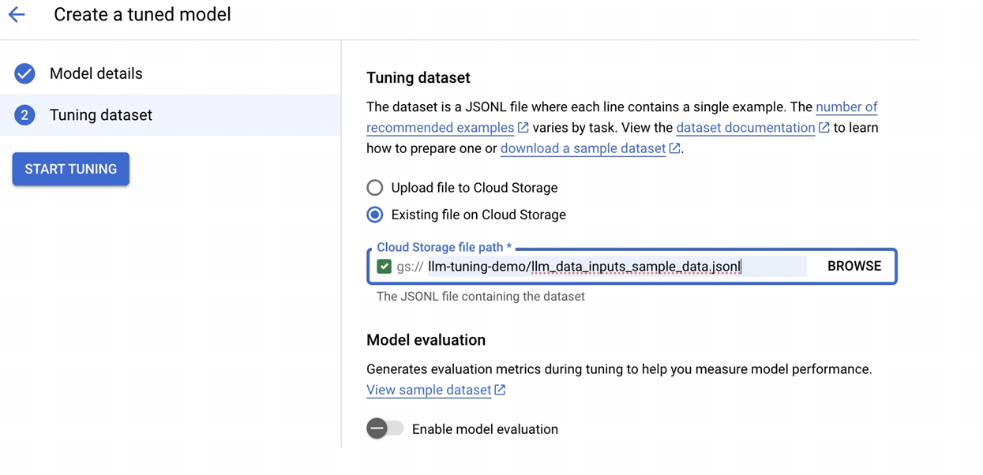

Slide 13
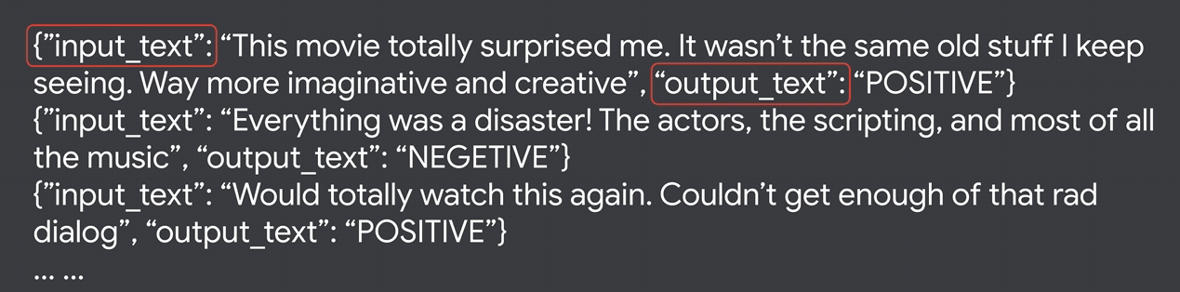

Slide 14
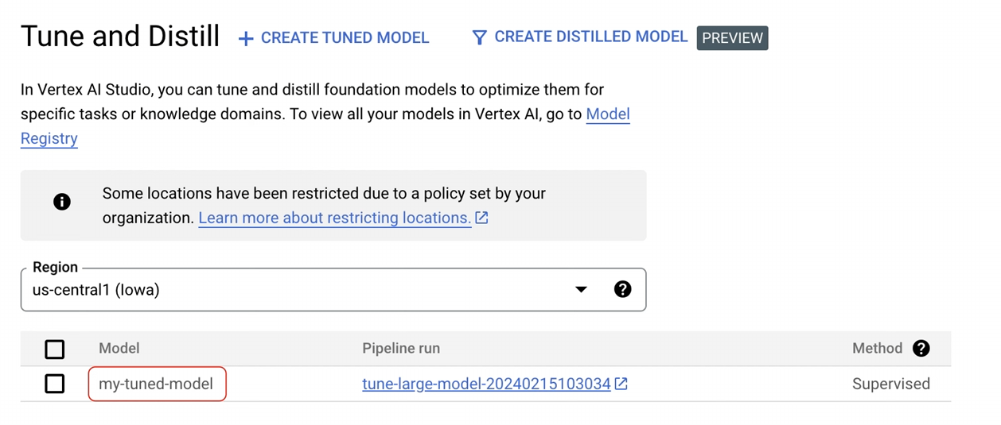

Slide 15
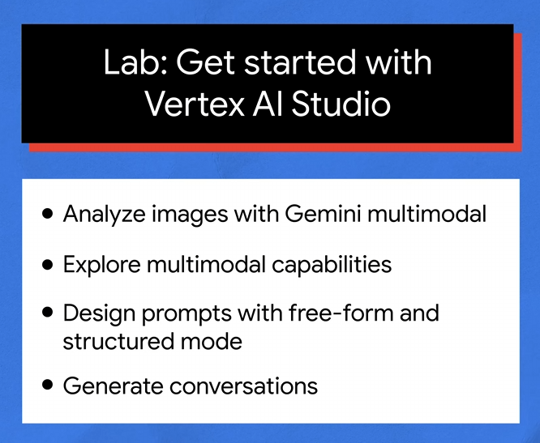

Slide 16
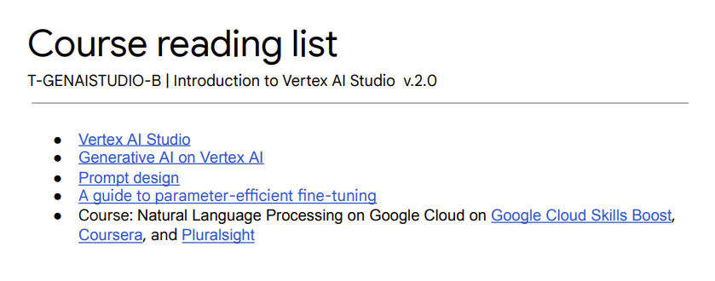
Notes:
https://cloud.google.com/generative-ai-studio
https://cloud.google.com/vertex-ai/generative-ai/docs/learn/overview
https://cloud.google.com/vertex-ai/generative-ai/docs/learn/prompts/introduction-prompt-design
https://arxiv.org/pdf/2303.15647 -- Scaling Down to Scale Up: A Guide to Parameter-Efficient Fine-Tuning
https://www.cloudskillsboost.google/course_templates/40 -- Natural Language Processing on Google Cloud

Slide 17
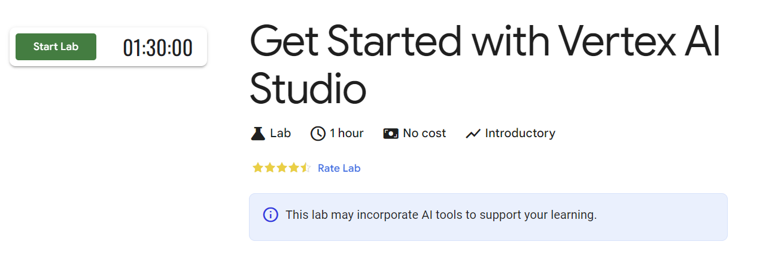
Notes:
https://www.cloudskillsboost.google/focuses/86502

Slide 18


